Slide 1
AI Seminar
01
Data
Neural Networks and CNN
Environment setup
Tensorflow, Keras
OpenCV
Notes:
Hello and welcome to the first seminar on A.I. Programming.
In this seminar we will cover the following topics;
- data: What is data, why its important and how to get it.
- Neural Networks and Convoluted Neural networks. What are they, and how do they work. We will go into the theory at a high level. (translation note: “high level” in computer science means “vague”)
- Setting up an environment for development of an image classification system. What are some popular tools and frameworks.
- Introducing the tools and frameworks, specifically Tensorsflow and OpenCV.

Slide 2
End goals
Train a Convoluted Neural Network (CNN) to do facial recognition.
Retrain a model to recognize animals, using “Transfer Learning”.
python Realtime_classify.py –model/faces
Notes:
The things you should be able to do at the end of this seminar are:
Understand basically what a neural network is.
Understand the use case for convoluted neural network.
Compile and train a CNN for facial recognition.
Use a model to classify data.
Retrain a pre-compiled model for classification of animals.

Slide 3
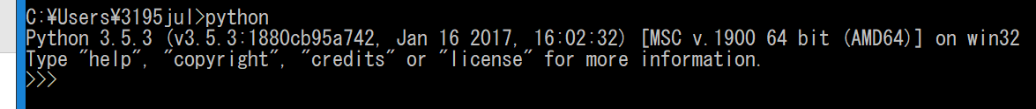
Environment Setup - python
Python is a simple but powerful scripting language.
Python 3.5
-check if python is already installed. If not, download and install.
-don’t install in “program files”. Make a memo of where you install it
https://www.python.org/downloads/release/python-354/
– check python and set PATH
Notes:
Lets set up our environment. Of course A.I. programing can be done in any language, but due to the wide availability of tools, C++ and Python are very good choices.
We will install python now. Check if version 3.5 is installed. We will use this version as its best compatible (at the time of writing) with the tools we will use.
You can check the installation status by trying to run it in a terminal with “python”. If you have an older version or its not installed, install it.
Make sure to download the correct version for your machine (x86 or x64).
Avoid installing under “program files” in windows. c:\\py35 is good.
Now check if its been added to the path correctly. You can do this by again checking if it runs in a terminal.

Slide 4

Environment Setup - python
This error message means that you need to append Python to the PATH.
Open System (Windows KEY + pause)
Advanced system settings
Environment Variables
SYSTEM Variables -> find PATH
Edit system variable
Add the path of the folder that holds python.exe
Add the subfolder /Scripts
example: “C:\\python35” and “C:\\python35/scripts”
Notes:
If you see this error message, python is not in the path.
Follow the steps to fix that.
We also need the scripts directory so that we can use various python tools.

Slide 5
Environment Setup – Other DLLs
Some other DLLs are necessary.
1. Microsoft Visual C++ 2015 Redistributable Update 3 (x64 version)
https://www.microsoft.com/en-us/download/details.aspx?id=53587
Make sure to get the correct architecture.
2. Check the DLL installed correctly.
>where msvcp140.dll C:\Windows\System32\msvcp140.dll
Notes:
There are some more DLL files that are required for the various tools we use.
You can first check if you need it with the “where” command in a terminal
Download and install if necessary. Make sure to get the correct version.

Slide 6
Environment Setup – Py Libs
Some other Python libraries are necessary (in our demo project(s).
OpenCv.
Numpy
HPY5
Pillow
Notes:
Now we need a few python libraries.
OpenCV: This is a very popular library for image manipulation, with api for python and c++. As we are doing image classification, we need a tool to pre-analyze our images and deliver to the A.I. model a cleaned up image.

Slide 7
Face Recognition CNN. -DATA
OpenCV
OpenCVはPython2.7のAPIだけど下のURLでPython3で使えるバージョンがあります。普通にPIPにインストールしたら、Python2Verだから、下のリンクからインストールしてください。
python 3 version: http://www.lfd.uci.edu/~gohlke/pythonlibs/#opencv
Download to desktop (or somewhere).
Open a command window;
Verify install by opening a python shell and then trying,
> pip3 install C:\Users\USERNAME\Desktop\opencv_python-3.3.1-cp35-cp35m-win_amd64.whl
>>> import cv2
Notes:
OpenCV is actually compiled for python 2.7, but we are running python 3.5. Therefore we will download a wheel compile for python 3. Get it at the link here.
Then run the pip3 command to install it.
After its installed, we can verify its installed by trying to import it inside a python shell.

Slide 8
Environment Setup – Py Libs
Some other Python libraries are necessary (in our demo project(s).
>pip3 install numpy >pip3 install pillow >pip3 install scipy >pip3 install h5py
Notes:
Lastly, we install the other required python libraries.
Numpy is a library for doing mathematics. It used compiled C code. Python is rather slow, so using numpy makes such math intensive code a lot faster.
Pillow is another image manipulation library like OpenCV.
Scipy has many convenient tools, some of which are used purely for convenience sake.
H5py allows us to binarize data and save it.

Slide 9
Environment Setup - CUDA
CUDA lets us use the GPU to do processing. It’s faster.
Cuda is only available if you own a Nvidia GPU with Cuda support.
1. Open a run window;
“control /name Microsoft.DeviceManager”
2. Visit http://developer.nvidia.com/cuda-gpus and find your card.
Notes:
CUDA is a library by Nvidia which allows computations to be performed on the graphics card instead of CPU. As the GPU is a great deal faster than the CPU for such computations as are performed in training a CNN, it’s a good idea to use it if you can.
You can check if your computer supports CUDA by first identifying your display device in the device manager. Then, if it’s a Nvida, check if it’s a CUDA device on the nvidia site.

Slide 10
Environment Setup – CUDA (2)
1. Download and install Cuda 8.
https://developer.nvidia.com/cuda-downloads
- Windows PATHとCUDAの“Bin”DIRをつなぐ
- Copy the CUDA install directory (default is "C:\Program Files\NVIDIA GPU Computing Toolkit\CUDA\v8.0") and append it to the Windows Path
2. Download and install cuDNN v5.1
https://developer.nvidia.com/cudnn
* cuDNNの.zipの中からファイルをコピーして、CUDAのDIRに入れてください。
“cuda\bin\cudnn64_5.dll” → "～\NVIDIA GPU Computing Toolkit\CUDA\v8.0\bin\"
"cuda\include\cudnn.h" → "～\NVIDIA GPU Computing Toolkit\CUDA\v8.0\include\"
“cuda\lib\x64\cudnn.lib” → "～\NVIDIA GPU Computing Toolkit\CUDA\v8.0\lib\x64\"
Notes:
If your computer is CUDA ready,
Install cuda 8. make sure you append to path.
Install cuDNN v5.1. It’s a library for deep neural network learning and CUDA.
Follow the onscreen instructions to install it successfully.

Slide 11
Environment Setup - Tensorflow
Tensorflow is an AI framework from Google.
1. Install Tensorflow for python. Open CMD window.
2. Verify correct installation. The Tensorflow "HelloWorld".
Open a Python shell.
..
..
..
..
WITH CUDA. | WITHOUT CUDA.
> pip3 install --upgrade tensorflow-gpu | > pip3 install --upgrade tensorflow
>>> import tensorflow as tf >>> hello = tf.constant('Hello, TensorFlow!') >>> sess = tf.Session() >>> print(sess.run(hello))
Notes:
Tensorflow is am AI framework from google.
Tensorflow can be both used as a development framework, to implement algorithms or research changes, or as a black box to call existing algorithms.
Tensorflow is used in house by google brain, and is quickly gaining popularity and dominating the AI scene.
Depending on whether you have CUDA or not, there are two versions. With or without gpu.
Install the version that is appropriate to your case.
You can verify install by importing in a python shell and running the tensorflow “hello world”

Slide 12
Face Recognition CNN. Training
Installing KERAS
https://keras.io/
Open a command window.
Verify it is installed correctly and using Tensorflow.
In a python shell.
You should see "Using Tensorflow backend".
> pip install keras
>>> from keras import backend; >>> print(backend._BACKEND)
Notes:
Keras as an abstraction layer of Tensorflow to make coding and calling algorithms easier.
Install it as on screen.
With that we have all the tools we will need for this seminar.

Slide 13
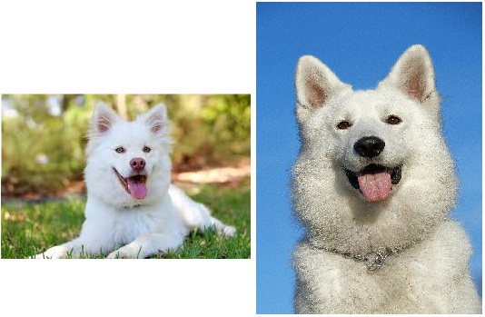
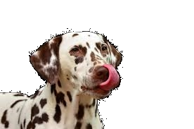
Data
The most import thing is Data.
A lot of Data.
Good data is not too specific.
Notes:
With any AI project, the most import part is your data. A great algorithm cant do anything impressive without data, and a good amount.
A good amount of data, means a lot. Data has become very valuable in this age, and it is the power of large amounts of data that has made companies like google and facebook so powerful. The reason that many of these tools are free to use is actually because its by your use that they get data.
Good data should cover all aspects of its class. If building an image classifier for dogs, the photos should cover a range of dogs, in different poses, different backgrounds. If the data is all like the left side of the example, the AI model cannot learn that dogs can also have patterns, can put there ears down, can move there tongue up … etc.

Slide 14
Obtaining Data
We need a lot of data to make good models.
This is why Google, Facebook etc. are powerful.
Create data yourself (as in demo project 1).
Image search. (Usage rights?, very time consuming).
Web-scraping (as in demo project 2).
Software as a free service
Buy it
Notes:
Obtaining data can be difficult. Obtaining good data is even harder. Again, this is why google and facebook are powerful, people give them huge amounts of data for free everyday.
There are a few ways to get data;
You can create it yourself. This can be very time-consuming but affords you a lot of trust in the data (provided you know what your doing). Sometimes this is the only way, and this is how we will do project 1.
Web/library search. You could use search for data that already exists. One should be careful about usage rights.
Web scraping. This makes the above more reasonable. By automating the search and collection process, things move much faster. The data may not be very good though (full of misappropriate data). We will use this method for the second project.
Offer software or services for free that collect data for you. Be Google!
Buy it. You can always buy data from many sources.

Slide 15
Data – Cleaning and Labeling
To train the model the algorithm needs context.
Supervised learning.
We need to give the data accurate labels.
Unsupervised learning – we don’t look at it yet.
Data is generally split into three groups,
- Training: The model is built over this data.
- Validation: The model is tested over this data.
- Test: The final score is computed with this data.
Notes:
When we train a model, we need to use data. The data used during training is correctly labeled, so the algorithm is told what it is. This is called supervised learning. Therefore it is important that this labeling is correct. Incorrectly labeled data is called “dirty”.
Cleaning data is an important step, and should be done properly.
Unsupervised learning learns on unlabeled data, but we are not looking at this today.
Data is generally split into three groups,:
Training. This data is used to actually training and shape the model.
Validation. This data is used to periodically test the status of the mode during training.
Test. This data is used to test the model at the end.
The reason why validation and test data are kept separate fom the training data is because we do not want the model to train on this data, or else it would just get 100%, and we wouldn’t know how good the model actually is for unseen data.

Slide 16
Training.
A Model is created by feeding it many (many) pieces of data, where the answer is known.
The model continually adjusts itself until it gets the right answer for these data pieces (back–propagation).
The model validates itself on validation data.
The algorithm adjusts some values and repeats the epoch.
It is continued until a desired accuracy, time limit or other stopping condition is reached.
Notes:
Training is the process by which a model is generated.
Many pieces of data are feed into the model. The model then uses its formula to classify the data. The answer is then compared to the correct answer for that data (remember, its supervised learning so that real answer is known).
The model then works backwards through its formula to adjust itself so that it would have got the correct answer. This is called back-propagation. In this way, the model is then trained on that data piece.
After an epoch, the model is tested with the validation data. The results are used to make some more adjustments and a new epoch starts.
This process is repeated until the stopping condition is reached.

Slide 17
Neural Network
Made up of many layers of Neurons.
A Neuron takes a number of inputs (x1~xn) with an associated weight (w1~wn). And an input of 1 with a weight of b, as a bias.
The neuron applies the inputs to a function, and applies an activation function.
1
b
x1
w1
f(w1.x1+w2.x2+b
Y (output)
x2
w2
Notes:
Neural networks are an algorithm that aims to mimic the way the brain works. Many neurons are joined together to make a network.
Each neuron takes a number of inputs, with an associated weight.
There is also an input of 1 with a bias, used to control the strength of a given neuron.
The neuron then applies function to the inputs and outputs (usually to the next layer of neurons).
I will go through briefly the formula and explain the aspects of a neural network, but honestly its not possible to get a solid understanding in half a day, so you will need to study this harder to really understand it. Fortunately we don’t really need to understand it to implement it thanks to tensorflow, so think of today as a introduction.

Slide 18
Neural Network
Activation function
Real word trends are usually non-linear. So we apply activation function to “force” non-linear relations.
Sigmoid. Squashes the output to be between 0,1
Tanh. ` ` ` between -1,1
RELU thresholds the value to be >0
Notes:
The neuron applies an activation function to its inputs.
As real world trends are usually non linear, we apply activation function to remove linearity.
Common activation functions are sigmoid, than and relu.
In fact, relu is the most common activation function. It simply filters all values below zero to zero.

Slide 19
Neural Network
Bias
With the bias, each node can be adjusted specifically. During training, this bias value is adjusted according to training results over epoch’s
Notes:
Each neuron has a bais. This allows the model to turn off or reduce the impact of any neuron on the end result of a classification. In this way the model can be adjusted during backpropagation.

Slide 20
Neural Network
The input layer has the inputs and the bias (=1).
These values are fed into the hidden layer with the weight on the connection (wn)
(All connections between all neurons have a weight)
Network
Input Layer Hidden Layer Output Layer
1 (bias)
1
f
y1
x1
f
f
y2
x2
f
Notes:
A neural network as three layers. The input layer, hidden layer(s) and output layer. Actually, the hidden layer can be increased to any number of layers, making the neural network a deep neural network.
The input layer has input for each data piece and a bias (1). These values are fed into the hidden layer with a weight. Each input connects to each neuron in the hidden layer. The weight is on the connection, not the neuron.

Slide 21
Neural Network
The hidden layer can be 1 or many layers (here is shown as one layer).
It takes weighted values from the previous layer, and applies its function f and the activation function, before outputting to the next layer.
Network
Input Layer Hidden Layer Output Layer
1 (bias)
1
f
y1
x1
f
f
y2
x2
f
Notes:
The hidden layer is called as such as it is in there that the AI learns all kinds of things itself. It takes weighted data from the input (or a previous level hidden layer) and applies its function before passing to the next layer (either another hidden layer or the output layer.

Slide 22
Neural Network
The Output layer has an output for each input neuron. It fully connects all the features the hidden layer learnt into one of the distinct classes of the input.
Network
Input Layer Hidden Layer Output Layer
1 (bias)
1
f
y1
x1
f
f
y2
x2
f
Notes:
The output layer takes all the computation from the many neurons in the hidden layer, and classifies into on distinct class (as dictated by the input layer). Thus it is called “fully connected”.
A sigmoid function is applied so that the classification fits nicely into a percentage.

Slide 23
Neural Network – Training Process
Training algorithm is back-propagation algorithm.
The data is labeled correctly. Supervised Training.
The network has initial weights -> random.
The network classifies an image. It is wrong (because weights are just random). But, the answer is known (supervised). Thus, we work backwards to fix weights to get a reasonable answer. -> Error propagation.
Repeat, the answer is a little better with the new weights.
Repeat, repeat, repeat. The accuracy is climbing.
Notes:
The neural network is trained with back-propagation (as we saw earlier)
The weights are initially all random.
The first classification is very bad/wrong, because the weights are random. But, the back-propagation fixes the weights so that they are correct for this data.
The process is repeated over and over for different sub-sets of the data. Assuming the data is good, the accuracy will climb until the peak is reached. (or we get stuck in a local maxima)

Slide 24
Neural Network – Training Process
After going through all the training data, the model knows the values to get the right answer for those specific examples.
- The model has learnt that data.
- It will be accurate for the training data, but not necessary to other, unseen data.
- Dropout helps alleviate this. Dropout is a random functions that simply randomly sets some weights to 0 (regardless of training results).
- Good data also helps ->
Notes:
After getting through all the data, the model is trained on the data.
It will be accurate on the data used as training data, but not necessarily on new data.
To alleviate this, foremost the data should be good. Once again consider the picture of the dogs. The data is not a good sample of dogs, so the model would perform poorly.
Additionally, the algorithm does something called dropout. Dropout randomly sets some weights/biases to zero. This cause the data to not train to perfectly to the data. (so it doesn’t think the training data and only the training data is a dog). It adds some vagueness back in.

Slide 25
Neural Network – Training Process
After going through all the training data, the validation data is used to check the current accuracy of the model using data the model has not been trained on.
The learning rate is adjusted and the process repeats.
Notes:
A learning rate is a value that impacts how much the weights are changed during back propagation.
If the weights where changed to get the exact answer each time, the model would change too much each time. So the learning rate defines how much the model can change itself each time.
To small a rate makes the model susceptible to getting caught in local maximas. To big a rate and the value may jump around wildly and miss finding a broad equation.
Learning rate can be static, or adaptive.
Adaptive learning rates can be mathematical, or simply “decay” (reduce over time).

Slide 26
Training.
Neural Network Summary
Each connection to each neuron has a weight.
Initial is random.
The Training data is classified with the model, using the weights.
Model then works backward and adjust its weights so that it would get the right answer (back-propogation).
Validation data is used to check accuracy.
Learning rate is adjusted if not static.
Re-run.
Notes:
In summary,
A neural network is a model that emulates the brain. It is built of many neurons.
Each neuron connects to each neuron with a weight. The weights are initially random, Then adjusted in training to build the model.
Training occurs be feeding data forward through the model to get an output, then comparing the result to the expected result. The difference is then used to feed backward through the model and fix the weights (with reference to the learning rate).
Validation data is used to check accuracy. The validation data is never used to train.
Learning rates can be static or adaptive.
The process runs many times until a stopping condition.

Slide 27
Convoluted Neural Network
Convoluted Neural Network is a type of neural network that is very strong for computer vision.
Four main parts
1. Convolution
2. Non Linearity (activation)
3. Pooling / sub sampling
4. Fully connected (classify)
Notes:
Convoluted neural networks are a form of NN that are proven to be very strong at image classification.
A CNN consists of four main parts.
Convolution, where the image is inspected with reference to pixel location.
Non linearity (the activation function)
Pooling and sub sampling. Inspected without reference to where sub areas are in the overall image.
Fully connected (classification layer)
Lets look at each part in more detail.

Slide 28
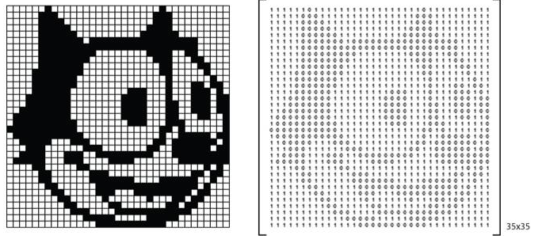
Convoluted Neural Network
Convolution
Images are processed as 2d arrays of pixel density.
Filters are learned by the CNN and applied to the image.
Notes:
Images are processed as 2d arrays (or 3d arrays if there is colour).
This allows the CNN to keep the pixel location information, which is very useful in classifying image.
Filters (convolutions) are learned during training, and applied to the image. The results of these filters are convolved images. These convolved images provide further information to the model.

Slide 29
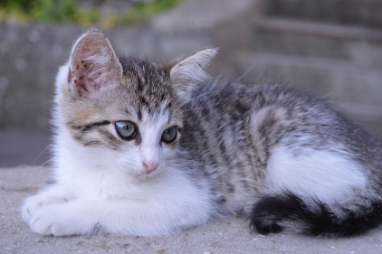
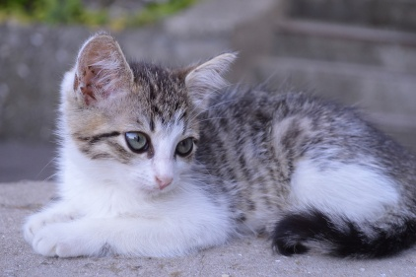
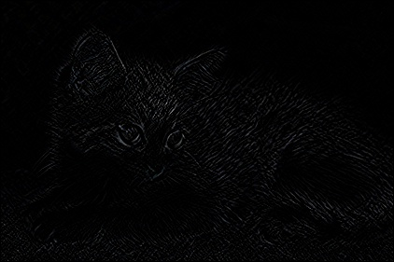
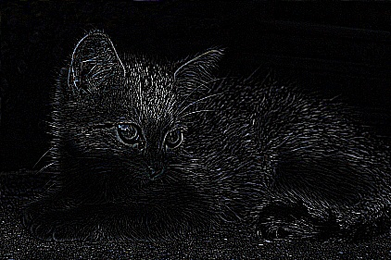
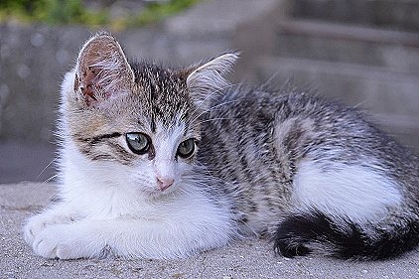
Convoluted Neural Network
Convolution (Filters)
Operation | Filter (3x3) | Convolved Image
Identity | 0 0 0 0 1 0 0 0 0
Edge | 1 0 -1 0 0 0 -1 0 1
edge | -1 -1 -1 -1 8 -1 -1 -1 -1
Sharp | 0 -1 0 -1 5 -1 0 -1 0
Image 32x32
The effects of filters on
the above image.
Notes:
Here are some examples of filters.
Notice the filters are small. This is because the filter will stride over the image.
Some common filters are edge and sharp. By identifying the edges of an image, we can see general outlines, which are more specific and general.

Slide 30
Convoluted Neural Network
Convolution (Filters)
The filter is 3x3 (in the example on the last slide)
but the image is bigger.
The filter strides the image and makes a feature map.
The image and the filter create the
Feature map by bitwise
Multiplication.
Notes:
In this example, the filter is 3x3 but the image is 32x32. Thus the filter must stride over the image. The amount by which the filter moves is called the stride. In this gif, the stride is 1. So it moves one pixel per.
Bitwise multiplication occurs between the filter and the image, and the resultant new array (convolved image) is built.

Slide 31
Convoluted Neural Network
Pooling / sub sampling
The feature maps are large and complex.
- hard to manage
- susceptible to overfitting.
- dependent on small details (fur patterns on dogs..etc.)
- scale dependent (where in the canvas is the image).
Notes:
Pooling is where images are sub sampled down.
This is done because the feature maps are large and complex.
They are still very specific and thus susceptible to overfitting. Overfitting is where the model classifies training data very well but fails to classify other images.
Using the large image may also train on small details which are not really important, like the angel of fur on a dog.
They are also scale dependent before sub sampling. This means it matters where the object is on the canvas. But we wont the model to not care about that.

Slide 32
Convoluted Neural Network
Non Linearity (activation)
Pooling solves these issues by down sampling.
max, average, sum, etc.
The pooled matrix becomes
the input for the next layer, the
process can repeat many times.
1
1
2
4
5
6
7
8
Max(1,1,5,6)
6
8
3
2
1
0
3
4
1
2
3
4
Notes:
Sub sampling solves this issues for the most part.
A group of pixels are sub sampled down into a new matrix. The sampling can be any math, such as max, average or sum. In this diagram we are using max.
The resultant matrix serves as the next layer (it is the neurons output).

Slide 33
Convoluted Neural Network
Visualization
http://scs.ryerson.ca/~aharley/vis/conv/flat.html
Notes:
In this we can see a visualization. Notice how the sub pooled images no longer resemble the original input to us. But this information is useful to the system in making the model equivariant.

Slide 34
Convoluted Neural Network
Fully connected (classify)
The many layers from convolution are brought together and fully connected. The softmax function is applied to ensure the sum of output probabilities is 1.
Images are thus translated into a percentage of likeness to each of the input classes.
Notes:
The last part of a CNN is the fully connected or classify later. In this part, all the many convolved image maps in the hidden layer are connected up to each of the output classes. The sigmoid function ensures that it outputs with a value 0-1 and the sum is 1. (100%).
With this images can be classified.

Slide 35
Convoluted Neural Networks - summary
Image and a smaller filter are multiplied together to make a feature map
These feature maps are learnt by the network during training.
The feature map is subsampled to reduce complexity, become equivariant and avoid overfitting.
Process is repeated.
The many filters are fully connected and softmax function is applied to give a % of probability of each input class.
Notes:
In summary,
An image is converted to a 2d array, in order to preserve pixel proximity information.
The model learns feature maps, which are smaller arrays.
The image and the feature map have bitwise multiplication applied to create convolved images.
The convolved images are sub sampled to reduce complexity and become equivariant.
These sub samples are fed into the next layer.
The process repeats through each hidden layer.
The many neurons in the hidden layer then fully connect to the set number of output classes, with the output being a number 0-1 which represents the probability that it is that class.

Slide 36
Training – Implementation with Tensorflow
With the use of Tensorflow (as a framework) ... We do not need to implement the algorithm.
But we do need to set it up. We will do this in the demo projects.
Tensorflow can also we used to implement new or tweaked algorithms. In fact Google Brain uses it.
Notes:
How do we implement all of this and actually train a model?
Fortunately by using Tensorflow we don’t need too. Tensorflow, as well as being a framework for implementation, also exposes algorithms that we can simply call.
Of course we need to know the general structure as detailed before so we know what to call, but we don’t need to program the mathematics.
This is how we will use tensorflow and CNN’s in this seminar.

Slide 37
Validating a Model - Tensorboard
Using Tensorflow makes debuging the CNN model much easier, thanks to the "Tensorboard" feature.
トレーニングが終わってから、Open a command window and run “tensorboard --logdir [directory of log files]”
Then visit: http://localhost:6006
特に'Accuracy'が安定になってきたかどうかを確認ように。もし'accuracy'はまだ増えていたら、training_stepsを上げて、繰り返す。
Cross entropy is the amount of change per epoch. Lower is better.
Accuracy should be stable at the time of termination. If it is still increasing, re-run with an exit param that would let it train for longer.
It is good practice to look at the tensorboard output after training a model, to see if you need a better exit param, and verify the model.
Notes:
Once a model is finished its training, it is a good idea to validate it and have a closer look at it before settling.
Fortunately tensorflow provides a very powerful tool for this called tensorboard.
we will use tensorboard during the project later to validate our models.

Slide 38
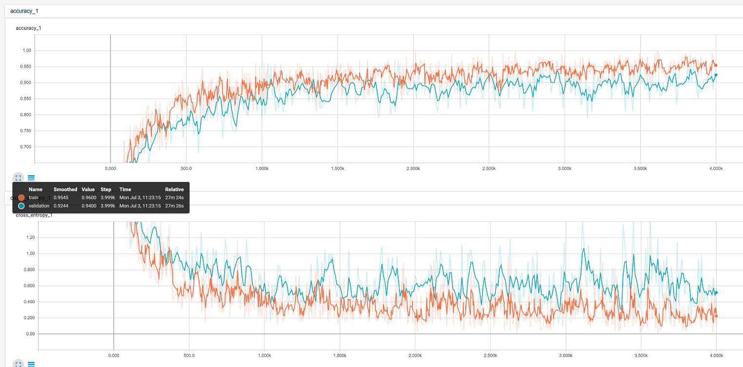
Validating a Model - Tensorboard
Notes:
This is a tensorboard graph from an older model.
It shows the training in red and validation in blue, the top half shows the accuracy and the bottom half shows the cross entropy.
Notice that the accuracy has settled and no longer grows toward the end. This shows that the model has trained to the peak (under this data with these settings). If the accuracy was still climbing at the termination, then you would be wise to run again with a longer stopping condition.
Also note that the training data and validation data are close (but could be closer?) this shows that the model may be overfitting.
There are many things that can be overserved in tensorboard that show whether a model is actually good or not.

Slide 39
Introduction - Summary
That is a very basic overview of the theory behind Convolutional Neural Networks.
Data is very important, and the better and more extensive the better the resulting model will be.
AI is not magic, it can only understand what it has been taught to understand, by the data.
CNN is a type of NN that is strong on computer vision.
Tensorflow is a good tool to make everything easier.
Notes:
To summarize this introduction,
Data is very important. Getting data can be difficulty because we need a lot of data. It is not enough to only have the algorithm, we need the data first and foremost.
Ai is not magic. It can only do what we train it to be able to do, with the data. Therefore, once again, it is important to ensure your data is good, clean and extensive.
A NN is a type of model that emulates the brain, with many neurons feeding into many more neurons.
A CNN is a type of NN that excels at image classification. It keeps pixel proximity information and relies on sub sampling.
Tensorflow, an api by google, makes everything much easier.

Slide 40
Project 1
Notes:
There will be two projects today, demonstrating two different type of ways to train a CNN
Lets start now.

Slide 41
Demo Project A. Face Recognition CNN
We will make a program to classify images in real time from a web-camera feed.
The classification will be faces. We will train the CNN for each person in this room, then try to recognise who is in front of the camera.
Make a project directory now.
- e.g. “AISeminar_01p1”
We are not editing code, but a good python IDE is “pycharm”.
Notes:
The first project is to make a program to classify iamges in real time from a web camera feed.
The classification will be of faces. We will train the CNN for each person in this room, then recognize who are in front of the camera.
We will start from the beginning, but all code is supplied. You can look at it later in detail.
Start by making a project directory, such as “aisemi_01p1” or somesuch.
We wont need to edit the code at all, but it’s a good idea to have an IDE installed for using python. There are a few IDE’s available for python, but I recommended “pycharm” because it has debugging features and auto formatting.

Slide 42
Face Recognition CNN. - DATA
There is no database of each of our faces, so we are going to create the data now. The easiest way is from a webcam.
The code ("Frame_Face_Capture.py") will capture frames and save them.
The following things should be done to increase accuracy,
Move your sitting position around during the capture.
Have someone change the lighting conditions periodically. Such as by dimming or tuning on/off lights, or opening blinds.
Pull many different faces, and speak to someone during the capture.
Notes:
We can get data by web scraping or buying it, but there is no database of our faces. At least not that we know off. Maybe facebook has it…?
In any case, for this project we need to make our own data. Taking hundreds of pictures one by one would take a long time, so instead we will just saves frames of a video as photos.
The code in the file “Frame_face_capture.py” does just this.
In order to get good data, there are a few things we should keep in mind whilst the program runs.
First of all, move around! Let the program capture your face from a variety of angles.
also, if possible we should variate the lighting conditions. Slowly open and close blinds ect.
Try to pull different facial expressions. Also, talk. Talking will case your face to contort in natural ways.

Slide 43
Face Recognition CNN. -DATA
We are only concerned with the face, so we also want some code to automatically crop the image to the face only.
To do this we need to make use of another python library, namely,
OPENCV
Notes:
We are only concerned with the face, so we also want some code to automatically crop the image to the face only.
To do this we need to make use of another python library, namely, openCV
Opencv is very popular tool for image manipulation.

Slide 44
Face Recognition CNN. -Data
The program also uses "HAARCASCADE" to find the face and crop to only that region.
Download the cascade and put in the project directory in a subfolder called "haar-cascades/“.
- haarcascade_frontalface_default.xml
- haarcascade_profileface.xml
The reason for cropping to the face is because it will make the program more independent of the environment.
Notes:
Haarcascade can locate a face in the photo, and then we simply crop out all the background.
The reason we are doing this is to make the program environment independent. If we didn’t do this, then the program may fail to classify our faces if we went outside or to a different room.
Its also cheap and easy to do, so in this context it makes perfect sense to do it.
Haarcascades are not as strong as CNN, so whilst this one can spot the face, it wouldn’t be as successful at classifying between different peoples faces.
Download the cascades and put them in a subfolder of your project folder called “haar-cascades”. Make sure to use the same folder name or the code will break.

Slide 45
Face Recognition CNN. -Data
Put the code "Frame_Face_Capture.py“ from the repo into project directory.
You may need to edit line 41, “cap = cv2.VideoCapture(0)” to point to your device if you have more than 1 camera.
to run the code, append the parameters
1. output directory
2. name of face (name of person)
3. --number_of_samples [int] (default is 60)
4. --photo_interval [float] (default is 1 second)
(Example)
Run the program, then share your archive of your faces' photos with others to build a collection of at least 4 people.
(4 classes of faces).
Note: This code isn't AI related, its just a simple script to get the images from the web-cam. In other words, don't worry about trying to understand it (unless you want to).
> python Frame_Face_Capture.py data Luke --number_of_samples 500 --photo_interval 0.1
Notes:
Download “frame_face_capture.py” into project root directory.
Run the code with the parameters explained on the slide. There is an example run command.
Output directory is where the photos will be saved.
Name of face is the label to apply this photos
--number of samples is how many photos to take (defuat=60)
--interval is how many to take per second (default=1)
If the program just closes without showing a video feed window, or else it shows a feed from the wrong camera, then you need to edit line 41 of the code.
Cv2 dot video capture(0) to (1) or something.

Slide 46
Generate the Data
Run the program twice.
, Then share your archive of the cropped version of your faces' photos. Share with others to build a collection of at least 4 people. (4 classes of faces).
> python Frame_Face_Capture.py data Luke --number_of_samples 500 --photo_interval 0.1
> python Frame_Face_Capture.py dataTest Luke --number_of_samples 5 --photo_interval 1
Notes:
Run it twice, with a different output directory. We are doing this so we will have some test data later!
Looking at the data folder, you will see there are two folders. The raw is uncropped and cropped is cropped.
Now is a good time to do some data cleaning. Since its not so many pictures (just 500), then we can quickly look if there are any bad photos.
Any easy way is to sort by size and delete any 0byte images. Also, if there are pictures of a face which is not appropriate to the label, delete them.
If you did do any data cleaning, the total count will be less than 500.
You really should generate more, but for the sake of convenience just copy some to get back to 500.
Now, share your images (just the cropped ones) with others so we can each have something like 4~5 classes of data.

Slide 47
Face Recognition CNN -Data
Download "Create_Dataset.py“ from Repository.
This code packages all the images into one file to pass it into
Tensorflow easier.
Notes:
Download “create_dataset.py” and put it in the root folder of your project directory.
This code packages all the images into one file, to make it easier to pass into tensorflow.
The program will have an error of each class doesn’t have 500 images (well actually the same number of images) so make sure.

Slide 48
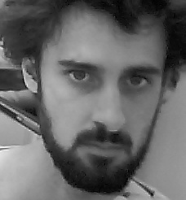

Face Recognition CNN -Data
Amongst other things, "Create_Dataset.py” does;
Convert images to 2d arrays.
Resize images (32,32)
Divide data-set into 3 groups
- Train
- Validation
- Test
Full size
32x32
Notes:
It changes the images from jpeg to 2d arrays (numpy format).
It also resizes images to 32x32 pixels. This might seem really small, but actually the CNN doesn’t need the smoothness and details that are found in the larger format. The key features are still present at 32x32, and are actually more obvious to the algorithm this way.
Finally, it divides the data up into our three groups,
Train, validation and test.

Slide 49
Face Recognition CNN -Data
Run the program
>python Create_Dataset.py -images_dir data/cropped -output_name faces
Data
-> Luke Patrik David
-> img1.jpg, img2.jpg, … | |
> im1.jpg, img2.jpg, ..., imgn.jpg |
> img1.jpg, ~~
Notes:
Lets run the program. You can see an example of run command here.
The params are –images_dir, its where the images are located.
The directories structure is as in the slide. With the folder name being the class name, then pictures inside.
And –output_name, it’s the name to give the packaged file.

Slide 50
Face Recognition CNN. Training
Now we have all the data packaged into a neat single file.
Now we can train the model. But first,
We will use Keras. KERAS is a 3rd party tool to make writing Tensorflow code even more simple.
Notes:
Now we have all the data packaged into a neat single file.
Now we can train the model. But first,
We will use Keras. KERAS is a 3rd party tool to make writing Tensorflow code even more simple.

Slide 51
Face Recognition CNN. Training
Download into your project the complete code, found in the repository as "model_simple.py“
This is the main code that needs to be understood. (The other bits of code until now where not really AI).
Lets look at the interesting bits.
Notes:
Download into your project root dir the code "model_simple.py“
This is the main code that needs to be understood. The other bits of code until now where not really AI.
Lets look at the interesting bits.
You will see its very self explanatory thanks to KERAS and tensorflow.

Slide 52
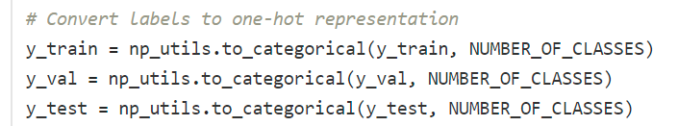
Face Recognition CNN. Training
For our data, each data(each image) belongs to exactly one class. e.g. Bob's face is Bob’s face and no-one else's.
One-hot is a labelling system where the data has a 1 for its true class
and a zero for all other classes.
It makes sense that we use one-hot in this system, because each face is
exactly one persons face.
Notes:
The first interesting part is “one-hot representation”.
For our data, each data(each image) belongs to exactly one class. e.g. Bob's face is Bob’s face and no-one else’s.
We need to a way to encode this. If we had a simple “type” field, and say an id there, ... well then the system might thing the ID has some effect of the system. It might conclude that two apples with id=2 sum into an orange with id =4. This is obviously wrong.
One-hot is a labelling system where the data has a 1 for its true class
and a zero for all other classes.
It makes sense that we use one-hot in this system, because each face is
exactly one persons face. There is no relationship between classes.

Slide 53
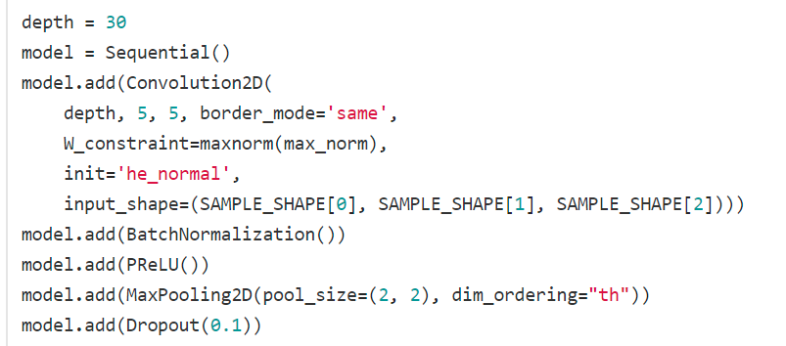
Face Recognition CNN. Training
The first thing we need to do is start building the model. We can use Keras to create a framework.
Here we are using 'Sequential()’. A sequential model is a linear stack of layers that build a CNN.
Notes:
Here we are building the actual model (the graph, the network).
Depth is the number of convolution filters to use. So the graph will learn this many filters and apply them all to the image on this layer. You can therefore see how the number of neurons will grow exponentially with each hidden layer.
We initialize the model as sequential type, that is one layer flows into the next.

Slide 54
Face Recognition CNN. Training
We add these layers also in the form on KERAS classes. As this is a CNN, we add 'Convultion2D' layers. These are the “hidden layers”
For more details on the KERAS classes and the arguments, look at the KERAS documentation
https://faroit.github.io/keras-docs/1.2.2/layers/convolutional/#convolution2d
Notes:
We add the first convolution layer to the model, set the number of (30) and size for (5x5) filters. You can see the full list of params at;
https://faroit.github.io/keras-docs/1.2.2/layers/convolutional/#convolution2d
The input shape specifies the type of img that we input. (1,32,32) would spec greyscale 32pixels by 32pixles, where as (3,128,128) would spec RRB(color) 128x128 pixels. This is only specified on the input layer, as subsequent layers input is dependent on previous layers output.

Slide 55
Face Recognition CNN. Training
We apply the activation, which is PRelu. Its a variant of Relu.
For more details on the KERAS classes and the arguments, look at the KERAS documentation
https://faroit.github.io/keras-docs/1.2.2/
Notes:
Next we apply the activation function. As described in the introduction, the activation removed linearity from the function. In this case Relu, which is simply n = max(0,n)

Slide 56
Face Recognition CNN. Training
The pooling (sub sampling) defines the scale the convolved images will be subsampled. Here we are halving the images with (2,2)
Notes:
The pooling (sub sampling) defines the scale the convolved images will be subsampled. Here we are halving the images with (2,2)
Remember pooling is a feature of convoluted neural networks that allows the model to become equivariant, as well as find features not otherwise observable.
The dim_ordering is just background configuration settings. It specifies what index of the array holds the depth.

Slide 57
Face Recognition CNN. Training
The dropout is the amount of neurons that are discarded.
The reason we do this is to avoid overfitting to the data.
Notes:
The dropout is the amount of neurons that are discarded.
The reason we do this is to avoid overfitting to the data.
By setting random neuron paths weights to zero, we effectively turn them off. This might seem counter productive, why would we want to forget our hard work? But actually its important because it stops the model from being too specific to the training data.
We want the model to be able to classify any image of the class, not just the exact images in the training data set.

Slide 58
Face Recognition CNN. Training
depth *= 2 model.add(Convolution2D( depth, 5, 5, init='he_normal', border_mode='same', W_constraint=maxnorm(max_norm))) model.add(BatchNormalization()) model.add(PReLU()) model.add(MaxPooling2D(pool_size=(2, 2), dim_ordering="th")) model.add(Dropout(0.2))
This code is repeated a few times. Each layer feeds into the next with double the amount of filters (depth*2).
Notes:
This code is repeated a few times. Each layer feeds into the next with double the amount of filters (depth*2).
With this growth of filters the hidden layers have increasing amounts of neurons. This means the model can see very unique and obscure shapes.
Notice the input shape is not specified, because KERAS can infer this information as it is connected to a previous convolution2d layer.
This code is repeated a few times, making the network a deep neural network. A deep neural network is one with more than a single hidden layer.

Slide 59
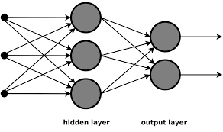
Face Recognition CNN. Training
model.add(Flatten()) model.add(Dense(2000, init='he_normal', W_constraint=maxnorm(max_norm))) model.add(BatchNormalization()) model.add(PReLU()) model.add(Dropout(0.5))
We finally fully connect the CNN by flattening it (transform the axis) and then add a Dense layer.
This Dense layer takes the many inputs from feature maps and outputs 2000 classifications.
Notes:
We finally fully connect the CNN by flattening it and then add a dense layer. Dense is the same, another terminology, as fully-connected.
To flatten is to transform the axis.
A dense layer takes the many inputs from the feature maps and classifies it. Here we are classifying into 2000 different groups.

Slide 60
Face Recognition CNN. Training
model.add(Dense(NUMBER_OF_CLASSES, W_constraint=maxnorm(max_norm))) model.add(Activation('softmax'))
We finally add another dense layer to cut down to the actual number of outputs we want, that is one for each class.
The softmax activation function is applied to ensure each output has a value 0-1, and the sum is 1. This is because we want to outputs to be a percentage.
Notes:
We finally add another dense layer to cut down to the actual number of outputs we want, that is one for each class.
The softmax activation function is applied to ensure each output has a value 0-1, and the sum is 1. This is because we want to outputs to be a percentage.

Slide 61
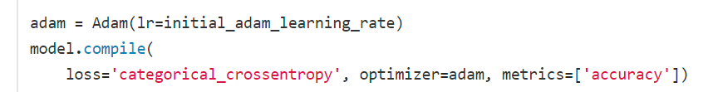
Face Recognition CNN. Training
We compile the model with the 'adam' optimizer. An optimizer is used to change the values of the weights to minimize the loss, between runs.
Here we have set it to change according to the 'categorical_crossentropy’.
Notes:
We compile the model with the 'adam' optimizer. An optimizer is used to change the values of the weights to minimize the loss, between runs.
Here we have set it to change according to the 'categorical_crossentropy’.
There are a few different optimizers, that either remain static throughout the run, or decay in time, or use math (like adam) to adjust according to some value (such as categorical crossentropy).

Slide 62
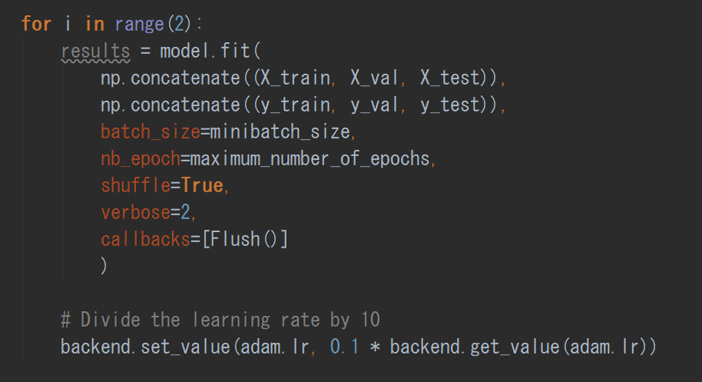
Face Recognition CNN. Training
Finally we call the model.fit() function in order to train the model.
The final output is the 3 files;
'model_weights.h5’.
'model_Arcitecture.json’.
'class_lookup.txt’. (Its just a translation from numbers to meaningful names)
Notes:
Calling the fit function on out model will cause the training progress to start.
The returned object is just a history/log. The model itself contains the weights after training.
Therefore we could now use this model object to start classifying from now.
We save these weights in whatever way we want, so that the model can be loaded up later. Therefore its easiest to just save the architecture and the weights values. We save them as binary data (.h5 and as a json string).
The class_lookup just translates the numerical classnames back to the real name. eg, 1=Luke, 2=Patrik, ~ etc.

Slide 63
Face Recognition CNN. Training
Run Training.
python Model_simple.py -dataset data/cropped/faces -output_path models/faces
Notes:
We can call and start the program as per the example command on the slide.
Training will take some time, especially if using a CPU instead of a GPU. We are only training ~500 images ~4 classes, so training will take ~1 minute on a powerful GPU or ~x15 minutes on CPU. With bigger more realistic projects training can take a whole day to days or weeks.

Slide 64
Tensorboard
Tensorboard is the logging system inbuilt into Tensorflow.
We can verify the graph had achieved stability or not, and spot other potential problems or areas to investigate.
http://localhost:6006
>tensorboard --logdir ./logs
Notes:
Lets look at the results in tensorboard. Tensorboard is tool bundled with tensorflow that reads tensorflow logs. It presents the logs as readable graphs and such.
Tensorboard is started from the command prompt and passing into to the directory of the logs to read.
Once it is started, view it in a web browser at localhost port 60006
(open tensorboard)
Look at the accuracy, it has stabilized at around epoch ~X~ . The validation data and training data are close too. It looks like a good run. If the graphs accuracy was still climbing at the termination, it would be worth running for a few more iterations.
If the validation and training data were vastly different accuracies, it might be worth taking a better look at our data, and/or making new data.

Slide 65
Face Recognition CNN. Classifying
Finally, we can use the model to classify.
We will use the second set of images we made earlier. ([name]Test)
Notes:
Lets classify some images. When we made the data, I asked you to also make a second test set. We will grab a few images from that and classify them. As they are your face, the prediction should be you.

Slide 66
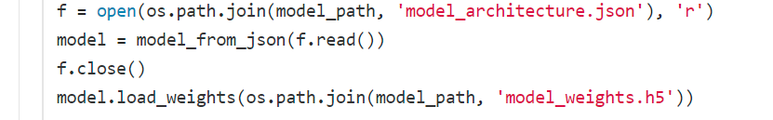
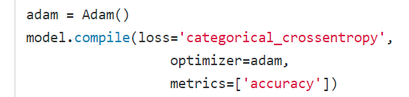
Face Recognition CNN. Classifying
Download the classify code from the repo "classify_model.py"
-First we load the model we created before with model.py.
KERAS has some handy classes that make this easy.
Then we compile the model.
Notes:
Download “classify_model.py” into the root of the project directory.
This code shows how we can load a model back up from the binary and Json that we wrote in training.
We once again compile it before use.

Slide 67
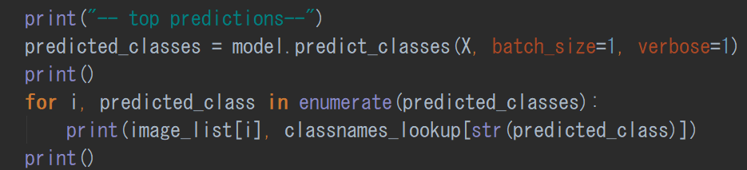
Face Recognition CNN. Classifying
The function that outputs results is “model.predict_classes”.
The output is a list of the class, for each image in the input directory.
This function only outputs the most likely class.
Notes:
There are a few methods for prediction. The first is the predict_classes method. It will give you the top prediction for each image in the array of images you pass to It was an argument.

Slide 68
Face Recognition CNN. Classifying
The 'predict_proba' function creates, for each image in X, a list of all the classes in the model. The classes have a value 0-1, which is the % probability of a match.
It’s a KERAS function, that returns the prediction for all classes.
>>>prediction_probabilities = model.predict_proba(X, batch_size=1, verbose=1)
Notes:
Another method is the predict_proba function. It gives at a fair bit more information than predict_classes. This time, we have a prediction probability for each class, for each image. With this we can see the confidence the model has that its prediction is correct.

Slide 69
Face Recognition CNN. Classifying
Here are my results.
classify_faces\david14_crop.jpg david patric luke classify_faces\david2_raw.jpg david patric luke classify_faces\luke46_raw.jpg luke david patric classify_faces\luke7_crop.jpg luke david patric classify_faces\patric0_raw.jpg patric david luke classify_faces\patric20_crop.jpg patric david luke
Notes:
Here are my results.

Slide 70
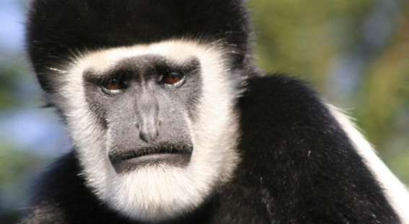
Face Recognition CNN. Classifying
Who is the most monkey like?
(Classified on an old model with David, Luke, Patrik)
Again its me, the beard I dare-say.
classify_faces\monkey1.jpg luke patric david
Notes:
Remember the model can only classify into the classes it knows about, as the deep layers take all the feature maps and squeeze them into these outputs. Therefore a picture of a monkey is classified into one of the classes. Well, its obviously due to the beard that my face is the most monkey like out of myself patric and david.
This point about the fully connected layer is good to remember when we do the second project. We will make use of this then.

Slide 71
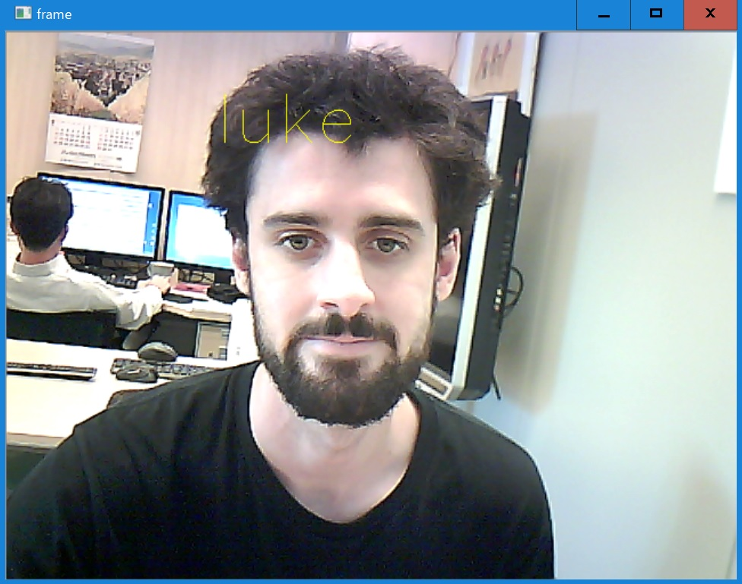
Face Recognition CNN. Classifying
Finally, look at the code “realtime_classification.py”
Download and run this code
If the program closes, line 44,
“cv2.VideoCapture(0)” ~Capture(1)
The process is the same, but we are
just grabbing our images from the
Camera and feeding them in directly.
>python Realtime_classify.py -models/faces
Notes:
Finally, download “realtime_classification.py” into the root of your project directory.
Run it with the command as shown on the slide.
If the program closes without showing a feed, making sure videocapture(0) is correct.
When a face is found in front of the camera, the model is used to classify it. It can classify more than one face.
That concludes project 1. You should now have the basic to implement a CNN for facial recognition. By studying the code you can see how it works in more depth, but with the Keras API open its easy to follow as we never actually needed to implement any mathematics.

Slide 72
Project 2

Slide 73
Demo Project 2. Simple CNN with Transfer Learning.
This time we will create a model with data scraped from the internet.
We will also use a different model training technique, called "Transfer Learning".
Transfer Learning
Now, make a new project folder
Notes:
This time we will create a model with data scraped from the internet. We will go through one method of data scraping with is popular in CNN development. In fact this data set is often used in competitions and in algorithm development.
We will also use a different model training technique, called "Transfer Learning". Remember how a CNN is made up of the input, then convolution and subpooling, then finally the fully connect layers. Well, consider that the convolution layer makes feature maps that we eventually classify into our set number of output layers. But if we step back before the fully connected layer, we just have feature maps. These features might be adequate to classify other images too!. By removing the fully connected layers, and then training with new fully connected layers we might be able to reuse the feature maps and classify something new. Transfer learning is this. Why would we do it? We will see why soon.
Please make a new project directory, such as “ai_semi01p2”

Slide 74
CNN with Transfer Learning -Data
This CNN will classify animal types.
There are many animal photos on the internet, so we are going to web scrape to get them
A very useful database of links exists, called “imagenet”
Notes:
The CNN we are going to build this time will classify animal types. Unlike our faces, there are many varied pictures of animals already in existance and freely available on the internet. But how to get them? Downloading one by one would simply take too much time. So we write a program to scrape them.
Fortunatly the hardest part is already taken care off for us. A website called “imagenet” exists, that has links to many images stored in a db structure. We can search and find links very easily.

Slide 75
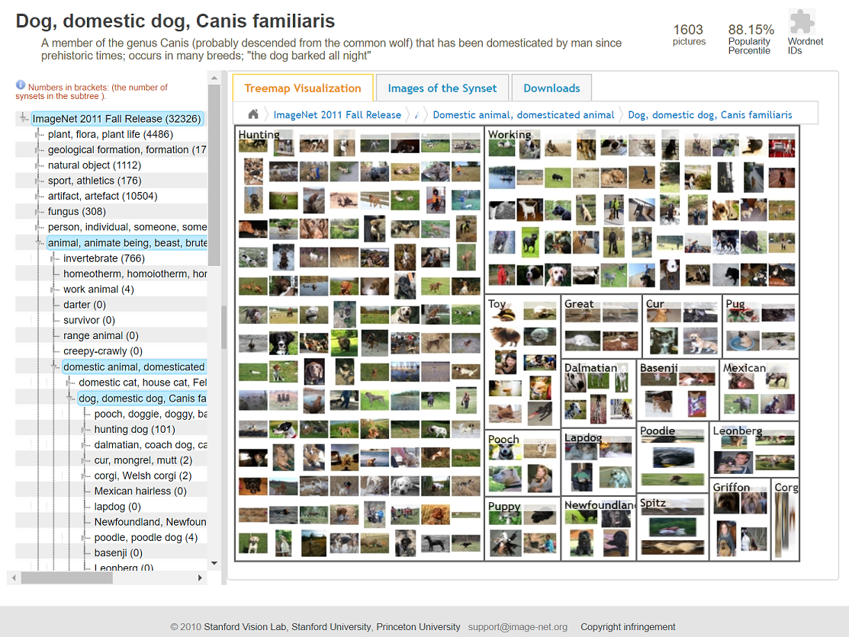
CNN with Transfer Learning -Data
1. Go to http://www.image-net.org/
2. Search “Dog”
3. You will see that “Dog” may be too
vague, because of the way Imagenet
is structured.
Lets try "Canis familiaris" instead.
4. The result looks good, so click into it.
Notes:
Visit the website and search for dog.
If you see a set that looks good, you can use it. Dog seems a bit vague though so lets try the animals scientific name “canis familiaris”. The result looks a lot nicer. Click into it.

Slide 76
CNN with Transfer Learning -Data
6. Click Downloads, then URLS. You will get a list of the URLS that are the locations on the net of each of these images. As the links could be dead, not all will work. Copy the Links to a text file in our project, name it Dogs.txt
7. We now have the dog.txt that contains many links to images of dogs.
Notes:
6. Click Downloads, then URLS. You will get a list of the URLS that are the locations on the net of each of these images. Copy the Links to a text file in our project, name it Dogs.txt
7. We now have the dog.txt that contains many links to images of dogs.
8. Make a folder called "junk".
As these are just links and not actual images that we downloaded, some links could be dead. not all will work. We therefore are wise to consider this in our fetching program. Lets look at that.

Slide 77
CNN with Transfer Learning -Data
We have links, but we still don't have images. So we need to roll a program to fetch the links.
Repo code "Get_Training_data.py” does this. Run it too see it working, then cancel it (because it takes ~>5 minutes).
As it takes too long, you can stop the run and instead download the data, “TrainingData.zip” instead.
Python Get_Training_data.py dog.txt
Notes:
Download into the root directory of your project the code “get_training_data.py”.
This code simply connects to the link and downloads the image. It is rather slow because it has to establish a connection with each site, and wait for connection.
Actually it takes quiet a long time, so to save everyone a lot of boredom, you can download the training data, named “TrainingData.zip”
Extract it into a “/data” folder in the project directory.

Slide 78
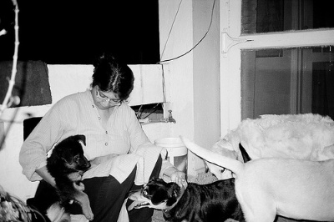
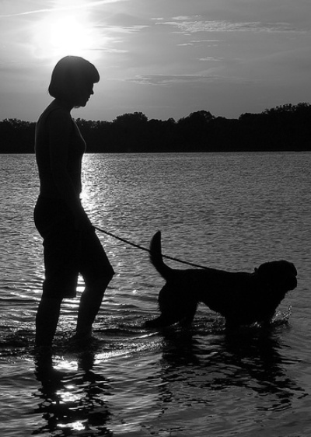
CNN with Transfer Learning -Data
Look at the data, notice
Images are greyscale. This is because
the precision from colour is not worth
the processing time. CNN works more
efficient on greyscale images.
Images have backgrounds.
Unlike the faces, this is OK because the
background are not all the same.
- The position of the dog on the canvas is varied.
Notes:
Look at the data, notice that images are in greyscale. This si because the precision gained from colour is not worth the processing time. There many be domains in which it would be worthwhile, but in this domain (animals) it is not.
Also notice that the images have different backgrounds, because they are real images. Unlike our faces in project 1 which where all taken in the same room at the same time, these pictures have many unique backgrounds. Because they are unique and varied, there is no need to crop (and in fact it would be very hard to do so).
Another point is the dog is not necessary in the center of the canvas. This is fine due to the sub pooling part of convoluted neural networks.
Finally, note that there many be other things in the canvas, such as people, balls, or even other animals. This is fine as long as two things are true;
- the correct animal is on the canvas
- the other animal is not an animal we are trying to classify as another class. On this point, a few might be ok but many occurrences of such data would confuse the training.

Slide 79



CNN with Transfer Learning -Data
DATA CLEANING.
You should always give your data a lookover (if possible) to remove obviously inappropriate data. Below are some examples of inappropriate data I found.
Notes:
When scraping data from links, there is bound to be some bad data from broken links. Make sure to check for such images. You can either do it programmatically or manually. Remove such images from your classes.
Note, in the provided data pack, the data has already been cleaned.

Slide 80
CNN with Transfer Learning -Training
This time we will re-train a strong model to understand our classes (dog, cat, horse, fish).
Retraining a model is the process of taking a very strong model (such as Googles Inception), and teaching it to distinguish something else.
It is very strong because the pre-model is already very strong, and thus we do not need a huge amount of data to get good results. Therefore our ~800 images per class is not as much of a disability.
The original code is written by Google, and can be fetched from the Tensorflow directory using Bazel.
However, I have packaged and slightly modified the code. It is found as "Model_Retrain.py" in this repo.
bazel build tensorflow/examples/image_retraining:retrain
Notes:
The training this time is different to before, as this time we are not going to train a model from the start, but instead use transfer learning to replace the fully connected layer of an older pre-trained model.
This works as the older model already has its feature maps and weights, we are just going to let it learn what maps and weight equate to these new classes.
Why would we want to do this as opposed to training from nothing? If your data is not so great in number, this can be a good alternative. Take googles “inception” model. This is a powerful model trained on very large data sets. By using the prior work and power of these model, we can get good results with few data.
The transfer learning code we use is written and supplied by google, and you can download it through bazel. We however will download a small re-write I made, as to avoid a few hassles.
Download into your project root the file “model_retain.py”

Slide 81
CNN with Transfer Learning -Training
Some things of note that googles code does;
Download googles model “Inception”. We will retrain Inception.
2. Bottlenecks.
The code uses a technique called "Bottlenecking" to speed up training.
As each image is used multiple times per train, the code creates summaries that it can process faster.
Another benefit is that if you change some settings but run again on the same data, the same bottlenecks can be used, saving a lot of time.
Notes:
Some things of note that googles code does;
Downloads googles model “Inception”. We will retrain Inception.
2. Bottlenecks.
The code uses a technique called "Bottlenecking" to speed up training.
As each image is used multiple times per train, the code creates summaries that it can process faster.
Another benefit is that if you change some settings but run again on the same data, the same bottlenecks can be used, saving a lot of time.
You can also programmatically distort the bottlenecks, in order to randomize your data.

Slide 82
CNN with Transfer Learning -Training
# Add the new layer that we'll be training. (train_step, cross_entropy, bottleneck_input, ground_truth_input, final_tensor) = add_final_training_ops(len(image_lists.keys()), FLAGS.final_tensor_name, bottleneck_tensor)
Training.
The model is trained in the same fashion, except this time we are only training the last later (of Inception).
Notes:
The model is trained in the same fashion as earlier, but instead of learning feature maps and training weights throughout the network, we only train the link between the feature map outputs and the fully connected layer.
We are trusting that the feature maps inception (the pre-trained graph) already learnt are strong and good for our data too, and are thus using them to classify some new classes.

Slide 83
CNN with Transfer Learning -Training
# Add the new layer that we'll be training. (train_step, cross_entropy, bottleneck_input, ground_truth_input, final_tensor) = add_final_training_ops(len(image_lists.keys()), FLAGS.final_tensor_name, bottleneck_tensor)
Training.
The model is trained in the same fashion, except this time we are only training the last later (of Inception).

Slide 84
CNN with Transfer Learning -Training
Training, we can adjust settings through input params.
+ -image_dir: トレーニングデータ（サブフォルダはクラスの名前）。 + --output_graph: このプログラムを使うはずの「output_graph.pb」 を保存するDIR。「Output_graph.pb」はTransfer Learningで、最もグラフ （Google Inceptionとか）が上のデータで変えてたグラフである。 デフォルトは "../retrain_graph/output_graph.pb"です。 + --output_labels: このプログラムを使うはずの「output_labels.txt」 を保存するDIR。「output_labels.txt」はクラスの名前。例えば「Happy, Sad, Scared」である。デフォルトは'../retrain_graph/output_labels.txt' です。 + --summaries_dis: TensorLogのためにLOGのファイルのDIR. デフォルトは '../retrain_graph/retrain_logs'です。 + --how_many_training_steps:トレーニングは何回で終わる . デフォルトは4000です。 + --learning_rate: Learing rateはどのぐらいWeightを変更する、前の Iterationのエラーに沿って. デフォルトは0.1です。 + --testing_percentage: テストのデータは何％がトレーニングにとして 使う. デフォルトは10です。 + --validation_percentage: テストのデータは何％がヴァリデーションに として使う. デフォルトは10desu。 | + --eval_step_interval: トレーニングとヴァリデーションの間はどの くらいことです .デフォルトは10です。 + --train_batch_size: .デフォルトは100です。 + --test_batch_size: .デフォルトは1です。 + --validation_batch_size: + --print_misclassified_test_images: The images that the model failed to classify are presented. This is handy to see where the data may be poor. + --model_dir: 作られたグラフの他のファイルを保存するDIR。 デフォルトは'../retrain_graph/imagenet'です。 + --bottleneck_dir: 。デフォルトは'../retrain_graph/bottleneck'です。 + --final_tensor_name: 新しい作ったグラフの新しいClassification layer の名前です。デフォルトは'final_result'です。 + --flip_left_right: トレーニングデータを半分が無作為に ミラーイメージさせるかどうか選択です。デフォルトは 0 です (つまりしないことです) + --random_scale: トレーニングデータの画像のサイズが何％無作為に 大きくする。デフォルトは０パーです。 + --random_brightness: 無作為に選んだトレーニングデータが画像の 明りさを変更する。デフォルトは０パーです。
Notes:
Googles code exposes many of the variables as params, so you have a lot of control over the run. You can read them on slide.
Some of the more usuable settings are;
--how many training steps: This configures the stopping condition. It is the “epochs” as in project 1.
--learning rate: the learning rate is static in this case.
-- test/val percentage. You can set them, but really the best is 80/10/10.
--print misclassified test images. This is a nice flag that allows you too see where the model is failing. If all the mistakes are in the dog class, you can assume the dog class’s data is poor.

Slide 85
CNN with Transfer Learning -Training
Training, example run
python model_retrain.py -image_dir data/animals --output_graph models/retrain --output_labels models/retrain --summaries_dis models/retrain/summary --how_many_training_steps 4000 --print_misclassified_test_images
Notes:
Run the program with a command similar as to the one on the slide.

Slide 86
CNN with Transfer Learning -Classifying
Once the training is complete the model is output at by default at; (See parameters section for more details on changing it)
- retrain_graph/output_graph.pb'
- retrain_graph/output_labels.txt'
We can now use this new model to classify images.
Notes:
Once the training is complete the model is output at by default at;
- retrain_graph/output_graph.pb'
- retrain_graph/output_labels.txt'
We can now use this new model to classify images.
Lets do that now.

Slide 87
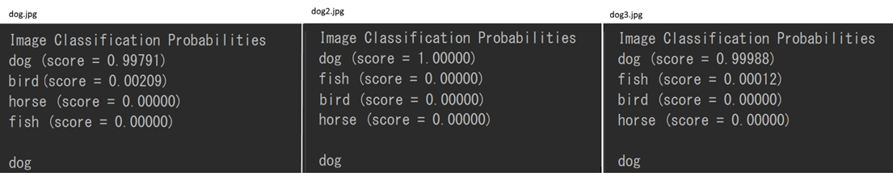
CNN with Transfer Learning -Classifying
The code in the repo called "classify_retrain.py"
It can be executed like so, in a command window.
>python classify_retrain.py classify_us/bird2.jpg -model_path retrain_graph/output_graph.pb -labels_path retrain_graph/output_labels.txt
The results show the top predicted class, and percentage of confidence.
Notes:
Download into the project root directory the ccode “classify retain .py”
Execute the program with the params –model_path, which points to our new retrained model, and –label_path, which points to the labels path.
The results will show the probability of the image for each of the input classes.
It is really accurate! This is the power of transfer learning. We build an animal image classifier with only about 1000 images.

Slide 88
CNN with Transfer Learning -Classifying
The results are very good, using random images from google.
But lets try a cat.
And the results are
```
Image Classification Probabilities
bird (score = 0.95378)
fish (score = 0.02915)
dog (score = 0.01706)
horse (score = 0.00001)
bird
```
The resulting class was bird! I thought it would go with dog to be honest... The point is, the model cannot predict cat because we never taught it what a cat is.
Notes:
If we try to classify a different animal, it will obviously fail.
Googles Inception (the graph we used) could actually classify cats, but we made it forget that was an output class and only taught it our four classes, so it now thinks everything is one of those four.

Slide 89
CNN with Transfer Learning –Summary
Summary
Using the re-train method, or "Transfer Learning", we can make powerful classifiers with limited data.
The model can only classify according to the training data.
The better the data, the better the results will be.
Notes:
In summary,
Transfer learning is a way to use pre-existing knowledge, in the form of a ready trained model, and teach it to classify other classes.
It is powerful because it borrows the power of already powerful models, and lets us make classifications even with limited data, and without requiring large amounts of time for training.
As always, data is king. Better data means better results. When web scraping data, it is important to do some data cleaning, as we can not be certain the data we are blindly downloading is good.
Thank you, the end.

